Slide 1
Data Visualization & Best practices

Slide 2
What is data visualization?
Data visualization is the process of representing data and information in a visual format such as charts, graphs, maps, and dashboard so that patterns, trends, and insights can be easily understood. Instead of just looking at raw numbers or text, visualization helps people interpret complex data quickly and make better decisions.
Instead of just looking at raw numbers or text, visualization helps people interpret complex data quickly and make better decisions.

Slide 3
Types of Data visualization :-
There are two types of the data visualization:-
Basic charts
Advanced charts

Slide 4
1 . Basic Charts :-
In data visualization, basic charts are the most commonly used and easiest ways to represent data visually. They are the foundation of data visualization and are used to summarize, compare, and analyze data clearly.
Basic chart consists of following different chart:-
Line Chart
Bar Chart
Pie Chart

Slide 5
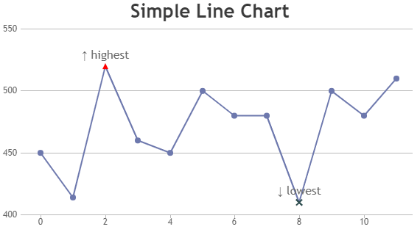
1. Line chart :-
A line chart is used to visualize the trends and changes over the continuous distribution between two variables. Or we can say that line chart is the BIVARIATE CHART.
Line chart is the chart that shows the graph between ‘num vs num’.

Slide 6
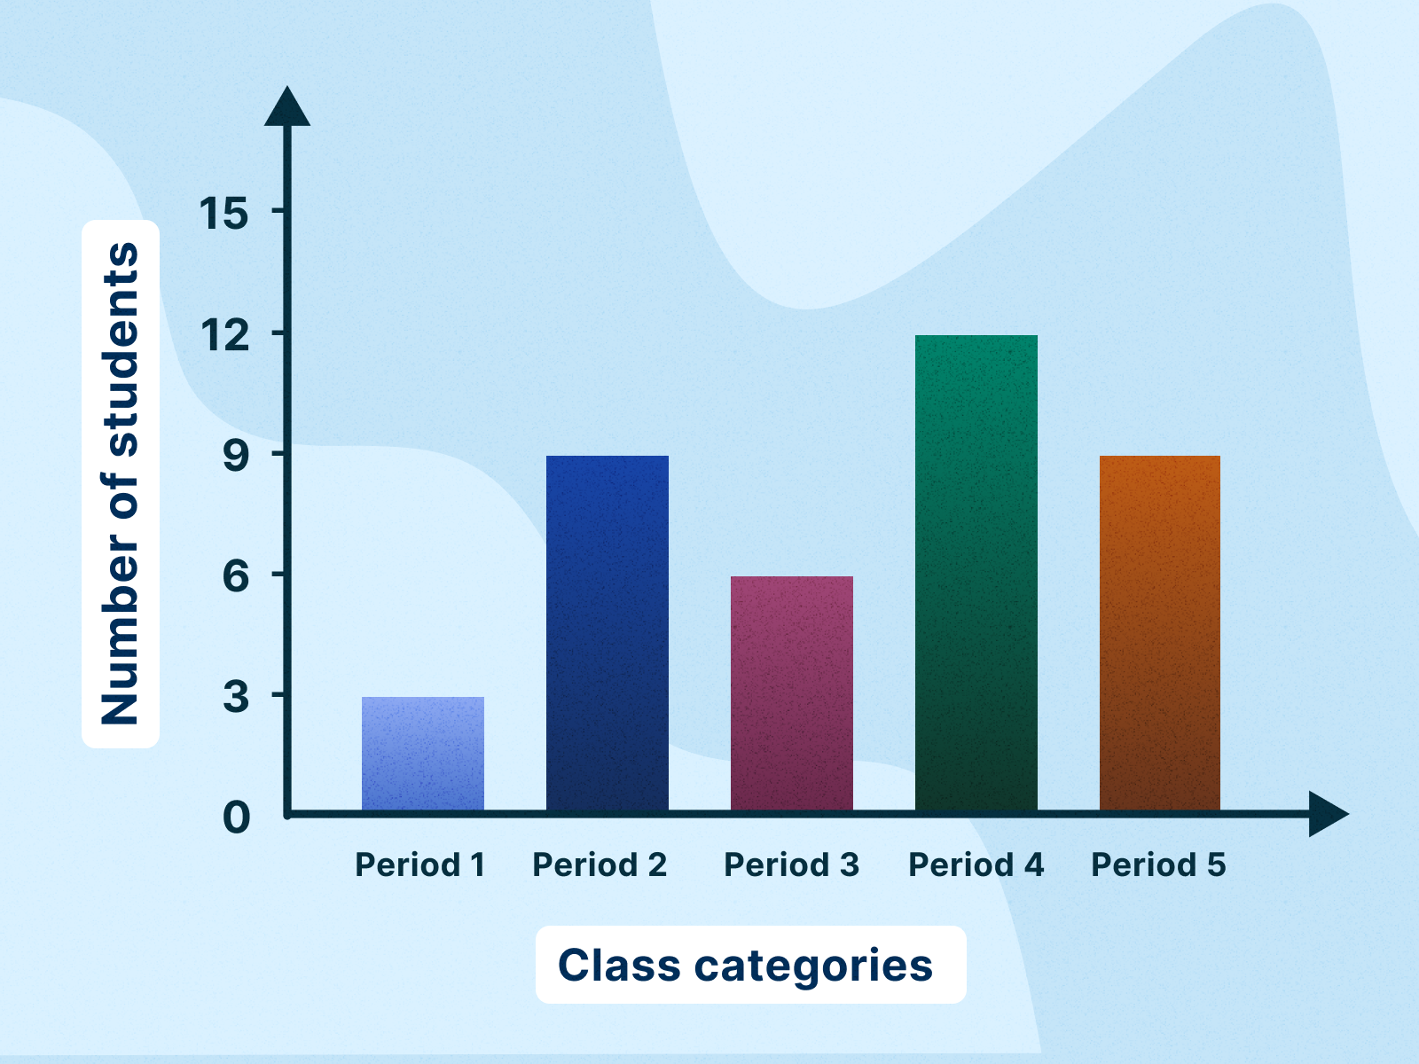
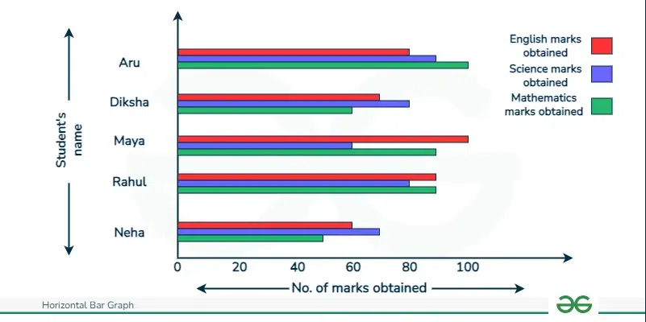
2. Bar chart :-
Bar graph is used to do the Bivariate Analysis i.e it shows the analysis between two variable which is ‘categorical vs numerical’.
Bar graph isi best for comparing values across the categories.
There are two types of bar chart :-
Horizontal bar chart
Vertical bar chart

Slide 7
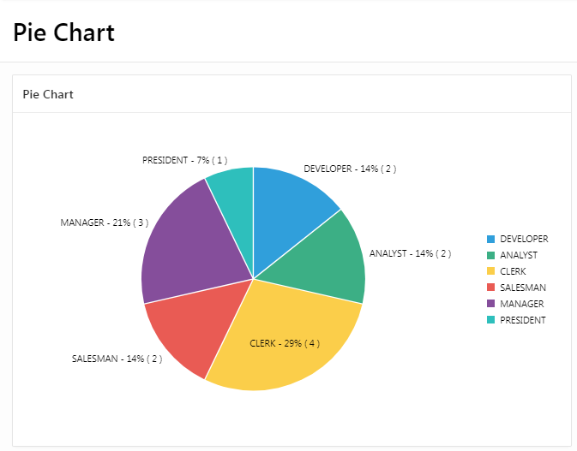
3. Pie chart
Pie chart is the Univarirate analysis, it is used to plot the proportion of categories for a single variable.
Pie chart is best to show the percentage share of categories.

Slide 8
Ii. Advanced charts :-
In data visualization, advanced charts are more specialized and powerful visualizations used when basic charts (like bar, line, pie) are not enough to show complex patterns, relationships, or multidimensional data.
Advanced chart consist of following different types :-
Histogram
Scatter Graph
Box plot
Heatmap

Slide 9
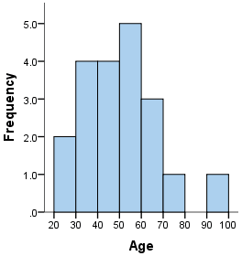
1. Histogram :-
Histogram graph is used to plot the distribution of a dataset by grouping the values into bins(divide values into the groups).
Histogram graph is used for better understanding the frequency distribution of the dataset.
Histogram is the Univariate analysis as it shows the distribution between one variable.

Slide 10
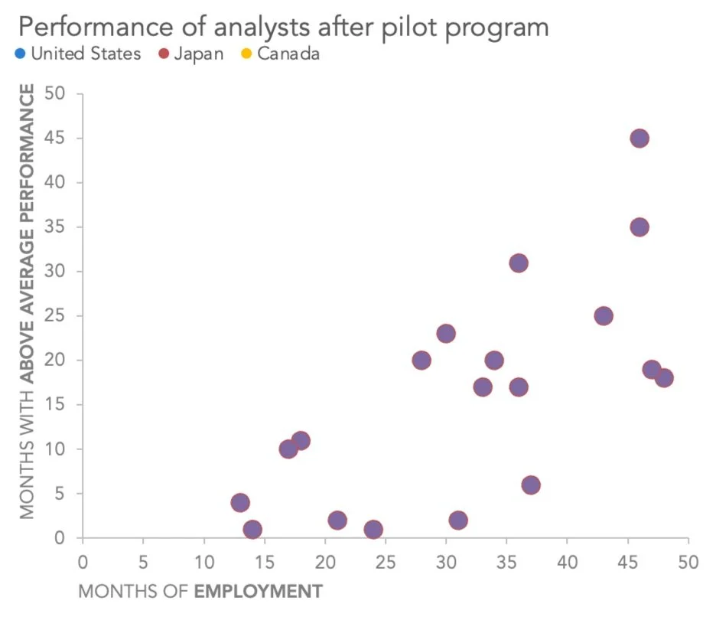
2. Scatter plot :-
Scatter graph shows the Bivariate analysis. The analysis between the ‘num vs num’.
It shows the graph as the dots in 2D space.
It is commonly used for finding the correlation or relationship between two variables.

Slide 11
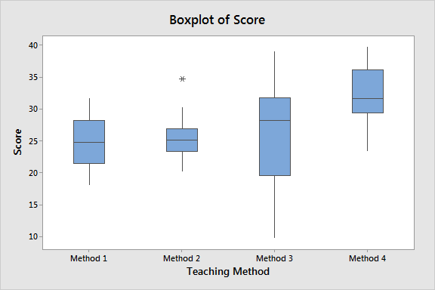
3. Box plot :-
A box plot visual tool that shows the distribution of a set of numerical data using its five-number summary: the minimum, first quartile (Q1), median (Q2), third quartile (Q3), and maximum.
It features a central box representing the middle 50% of the data (between Q1 and Q3) with a line marking the median, and lines extending to the minimum and maximum values, with individual points often used to denote outliers.

Slide 12
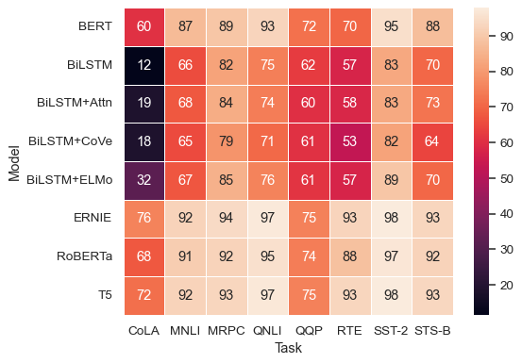
4. Heatmap :-
A heat map is a 2-dimensional data visualization technique that represents the magnitude of individual values within a dataset as a color.
The variation in color may be by hue or intensity.

Slide 13
Best practices in data visualization
Data visualization best practices focus on clarity and audience understanding know your audience and message, keep it simple and avoid clutter, choose the right chart for your data, tell a compelling story with context, use color and design elements effectively to guide the eye, ensure the visualization is accessible, and test it with users for continuous improvement.
The best practices in data visualization can be practiced using following steps : -
Clarity & Simplicity
Audience Focus
Design Principles
Avoid Common Mistakes

Slide 14
1. Clarity & Simplicity :-
Keep it simple: Don’t overload charts with too many elements. Extra gridlines, effects, and decorations distract the viewer.
Right chart for the data: For example, use a line chart for trends over time, bar chart for comparisons, and scatter plot for relationships.
Minimal colors: Stick to 3–5 colors. Too many colors confuse interpretation.
Avoid unnecessary 3D effects: 3D charts often distort perception and make data harder to interpret.
2. Audience Focus :-
Know your audience: Executives may want summary dashboards, while analysts may prefer detailed visuals.
Tell a story: A sequence of visuals that lead from problem → insight → action is more effective than random charts.
Highlight key insights: Use bold colors or annotations to direct attention to the most important data points.

Slide 15
3. Design Principles :-
Consistency: Maintain uniform fonts, colors, and style across all visuals for professionalism.
Labels & Legends: Always label axes, provide clear legends, and use descriptive titles.
Annotations: Add explanations or markers (e.g., “sales peak in Q4”) for clarity.
Accessibility: Use color-blind friendly palettes (e.g., ColorBrewer schemes). Don’t rely only on color; use patterns or shapes too.
4. Avoid Common Mistakes :-
Information overload: Too much data on one chart makes it unreadable. Break data into smaller, focused visuals.
Misleading scales: Avoid truncated axes (e.g., starting a bar chart at 50 instead of 0) as it exaggerates differences.
Too many categories in pie charts: Limit to 4–6 slices, otherwise use bar charts.
Ignoring context: Always include units, timeframes, or references (e.g., “% growth compared to last year”).

Slide 16
THANK YOU

